Slide 1
Transcription
DNA transcription produces a single-stranded RNA molecule that is complementary to one strand of DNA.
Transcription of DNA into RNA

Slide 2
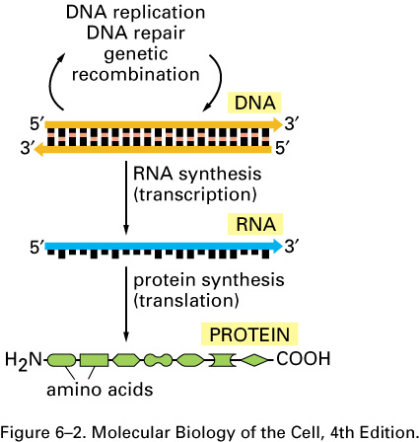
THE CENTRAL DOGMA
The pathway from DNA to protein.
The flow of genetic information from DNA to RNA (transcription) and from RNA to protein (translation) occurs in all living cells.

Slide 3
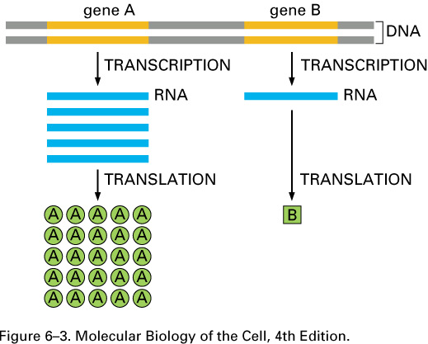
From DNA to RNA
Genes can be expressed with different efficiencies. Gene A is transcribed and translated much more efficiently than gene B. This allows the amount of protein A in the cell to be much greater than that of protein B.

Slide 4
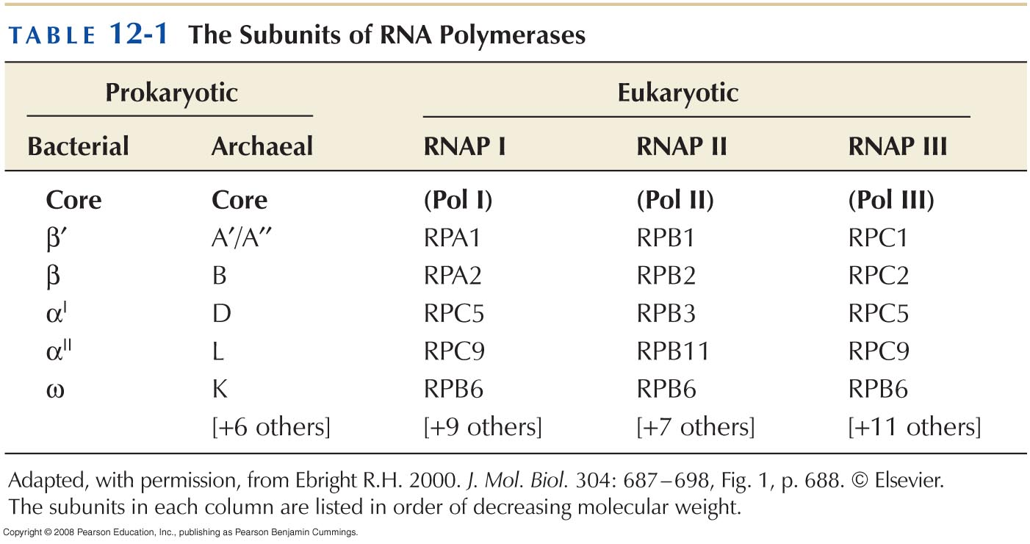
RNA POLYMERASE & TRANSCRIPTION CYCLE
RNA polymerases come in different forms but share many features

Slide 5
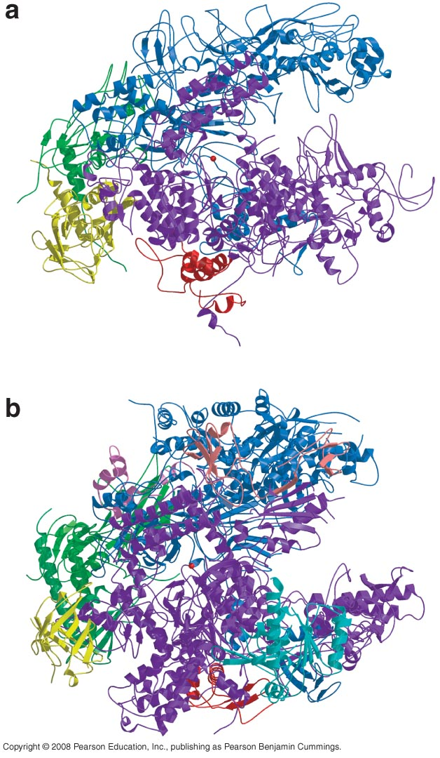
T. Aquaticus
Yeast

Slide 6
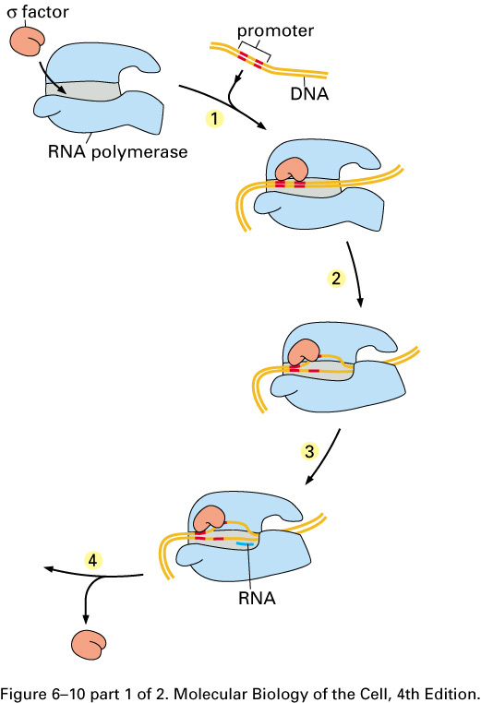
Signals encoded in DNA tell RNA polymerase where to start and stop
The transcription cycle of bacterial RNA polymerase. In step 1, the RNA polymerase holoenzyme (core polymerase plus s factor) forms and then locates a promoter (see Figure 6–12). The polymerase unwinds the DNA at the position at which transcription is to begin (step 2) and begins transcribing (step 3). This initial RNA synthesis (sometimes called “abortive initiation”) is relatively inefficient. However, once RNA polymerase has managed to synthesize about 10 nucleotides of RNA, s relaxes its grip, and the polymerase undergoes a series of conformational changes (which probably includes a tightening of its jaws and the placement of RNA in the exit channel [see Figure 6–11]). The polymerase now shifts to the elongation mode of RNA synthesis (step 4),

Slide 7
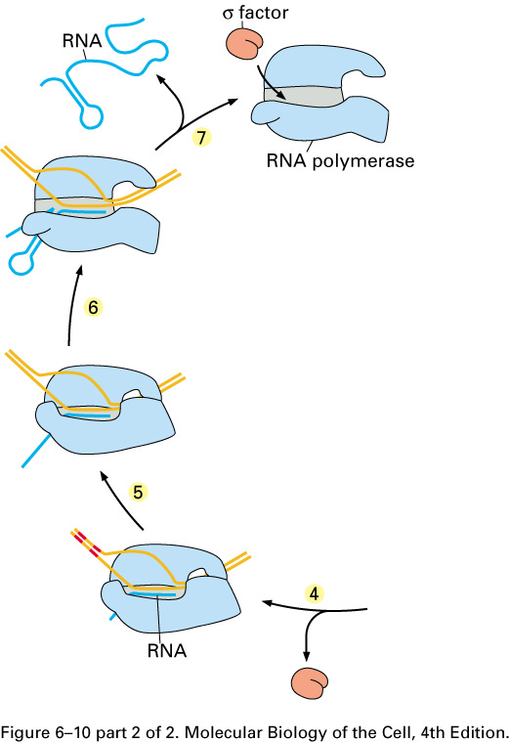
moving rightwards along the DNA in this diagram. During the elongation mode (step 5) transcription is highly processive, with the polymerase leaving the DNA template and releasing the newly transcribed RNA only when it encounters a termination signal (step 6). Termination signals are encoded in DNA and many function by forming an RNA structure that destabilizes the polymerase’s hold on the RNA, as shown here. In bacteria, all RNA molecules are synthesized by a single type of RNA polymerase and the cycle depicted in the figure therefore applies to the production of mRNAs as well as structural and catalytic RNAs.

Slide 8
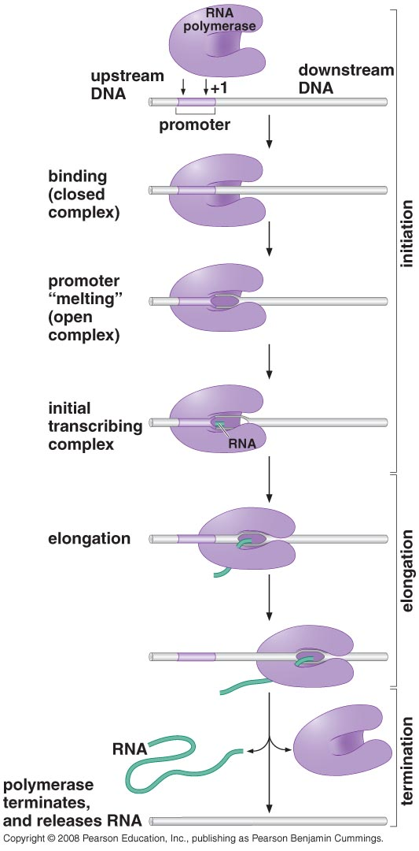
Transcription by RNA polymerase proceeds in a series of steps
Transcription initiation involves three defined steps:
Binding (form closed complex)
Promoter melting (form open complex)
Formation of initial transcription complex

Slide 9
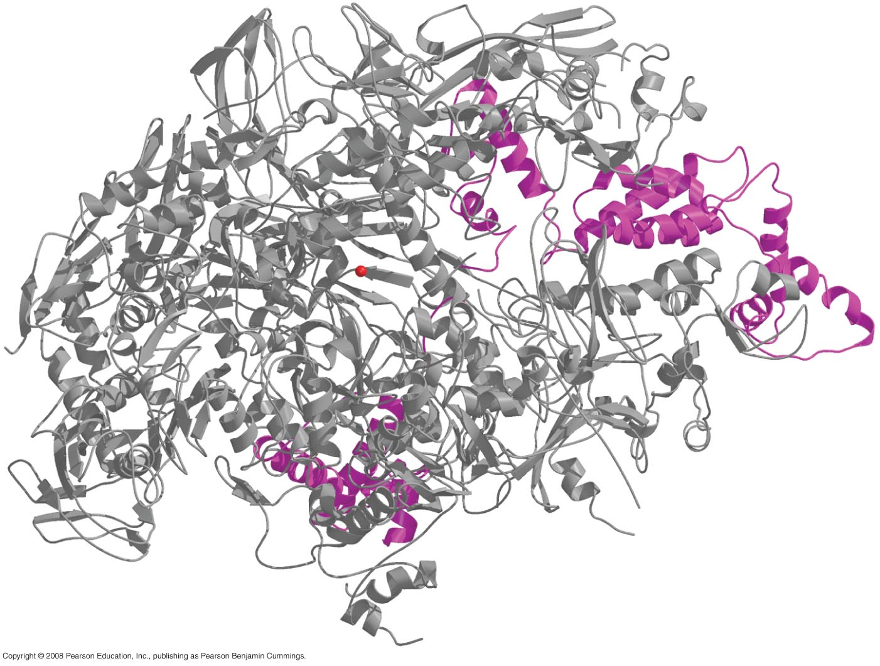
THE TRANSCRITION CYCLE IN BACTERIA
Bacterial promoters vary in strength and sequence but have certain defining features
RNA polymerase holoenzyme from T. aquaticus
(in purple is σ70 subunit that recognize promoter)

Slide 10
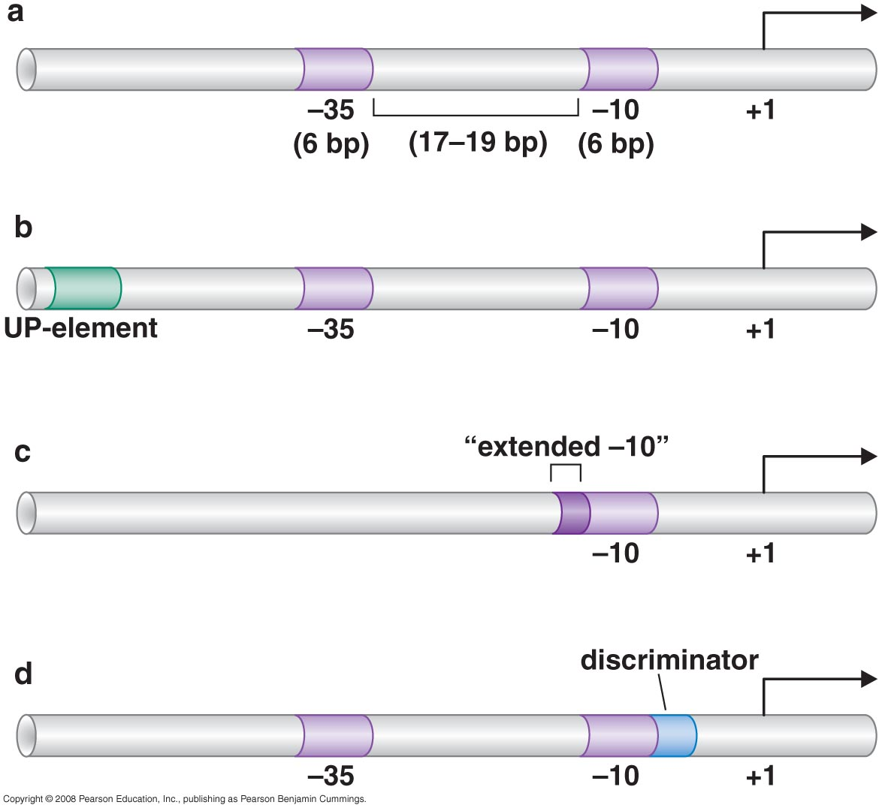
Features of bacterial promoters

Slide 11
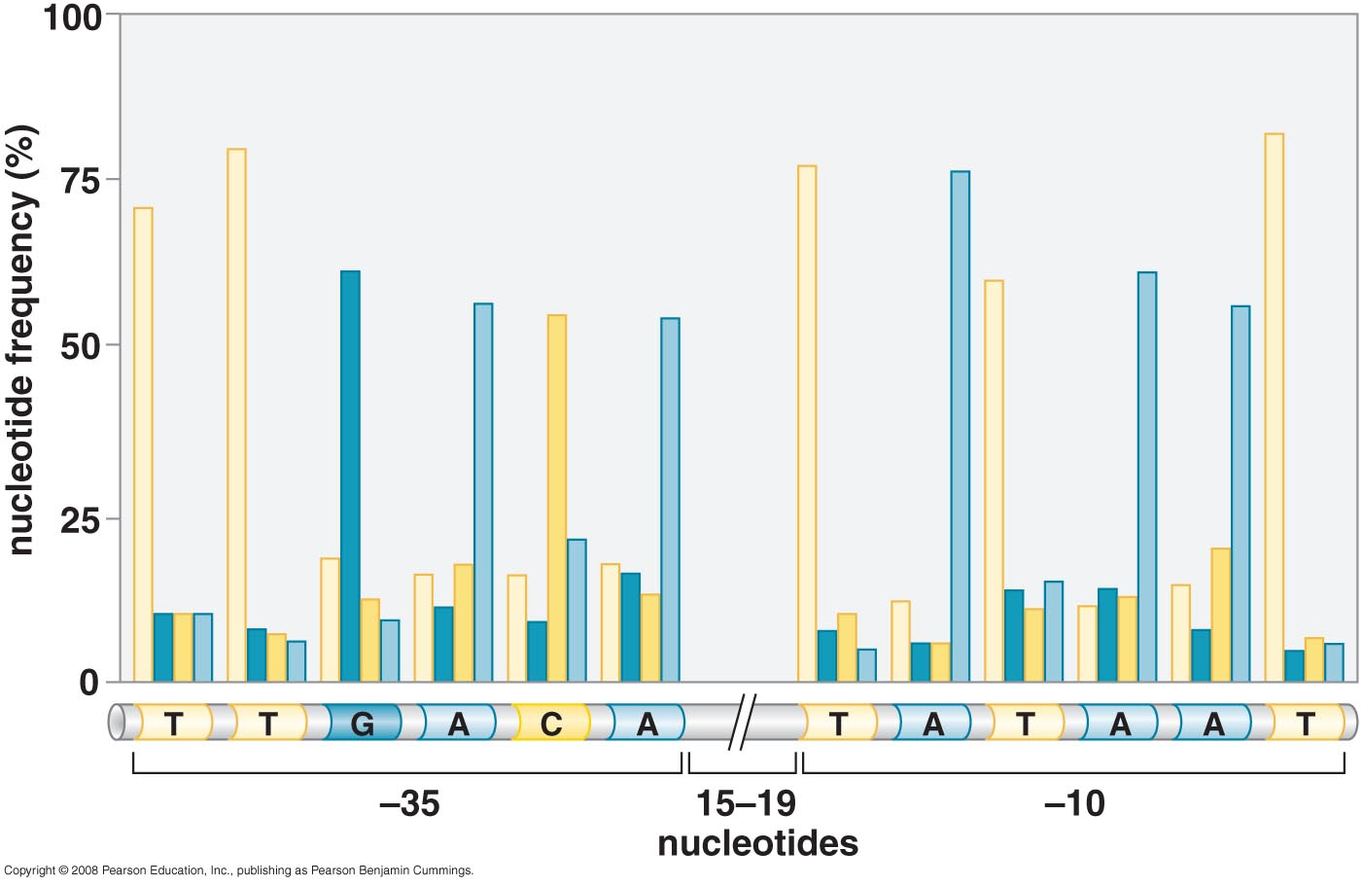
Promoter consensus sequence and spacing consensus

Slide 12
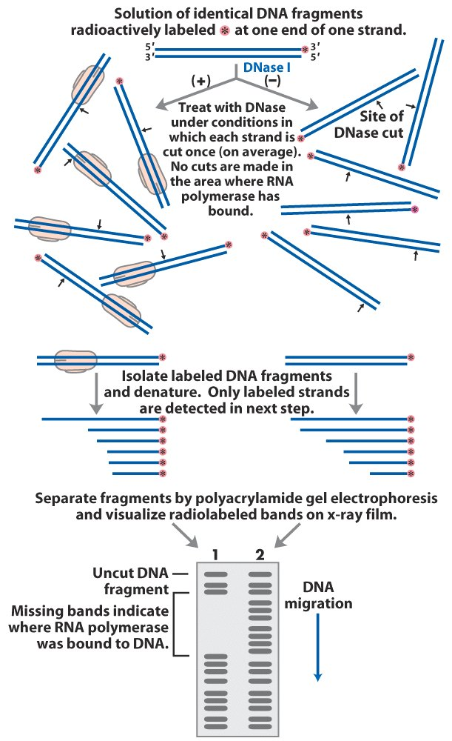
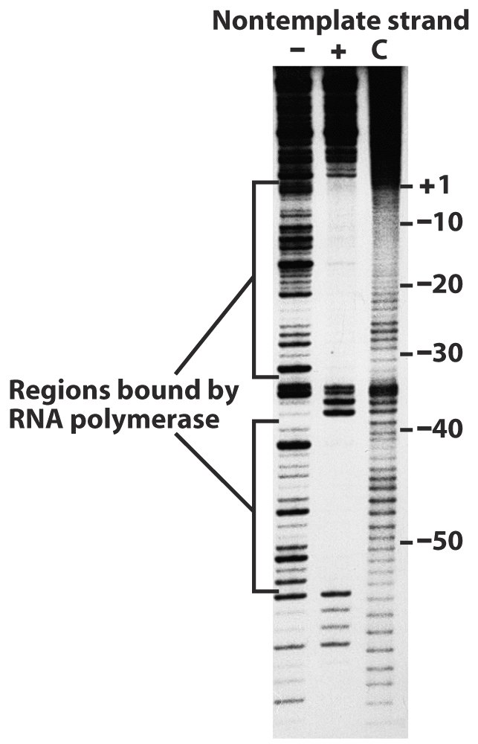
DNA footprinting:
RNA pol leaves its footprint on a promoter

Slide 13
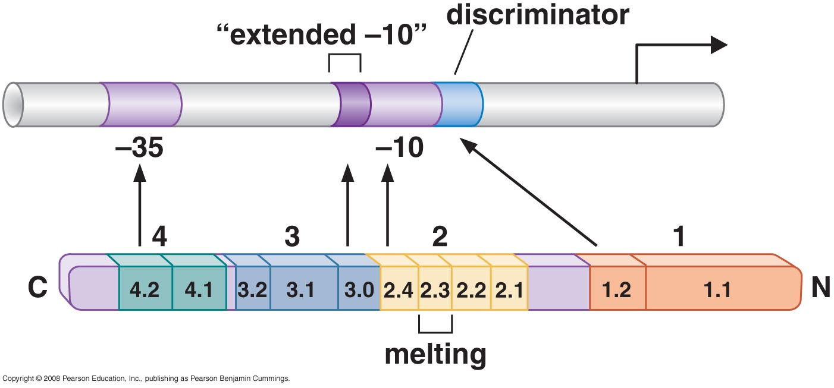
The σ factor mediates binding of polymerase to the promoter
Those regions of σ factor that recognize specific regions of the promoter are indicated by arrows

Slide 14
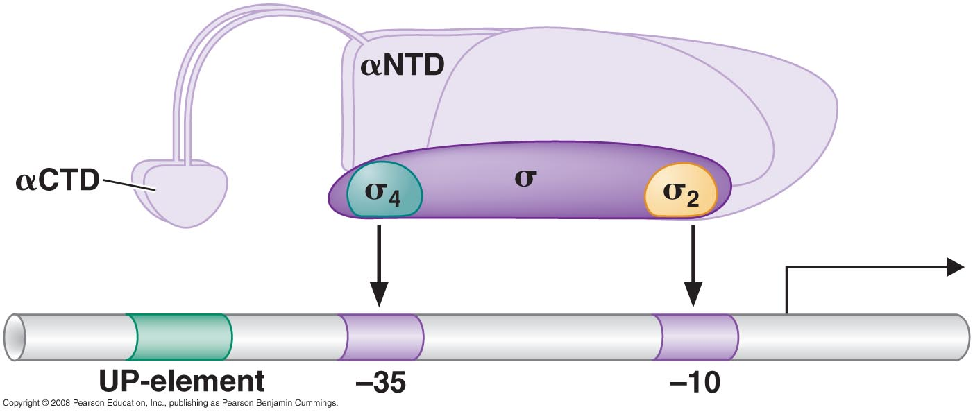
σ and α subunits recruit RNA polymerase core enzyme to the promoter

Slide 15
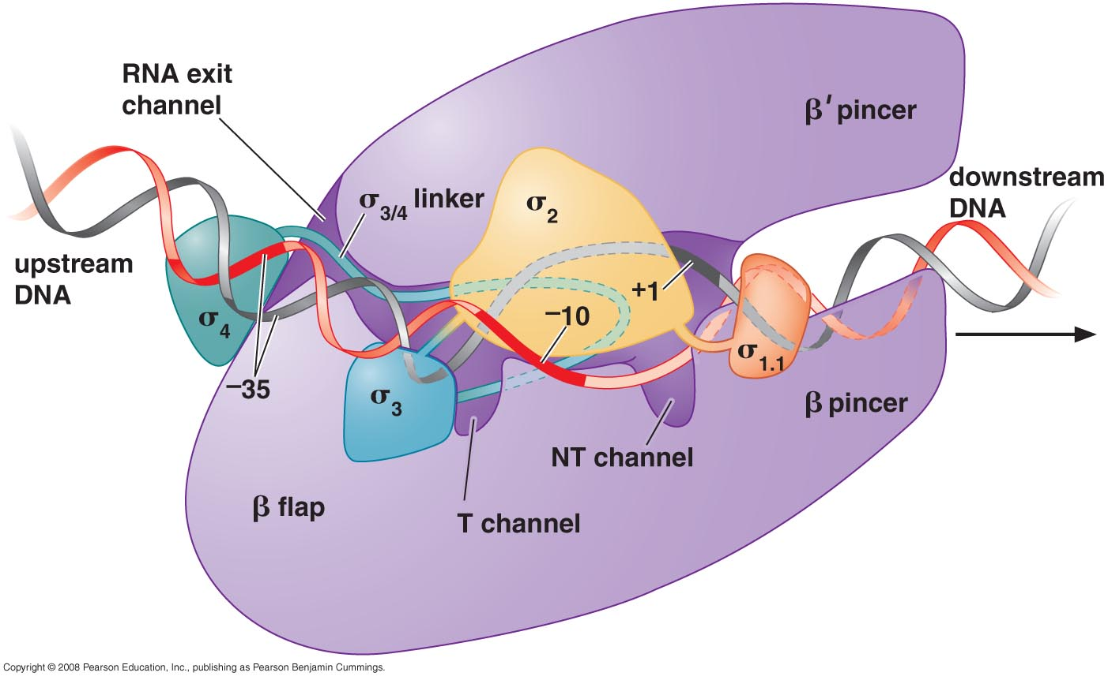
Transition to the open complex involves structural changes in RNA polymerase and in promoter DNA

Slide 16
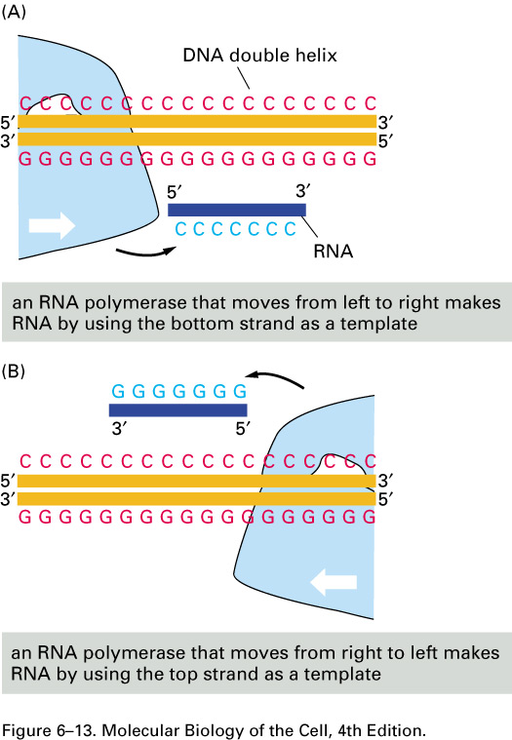
Transcription is initiated by RNA polymerase without the need for a primer
The importance of RNA polymerase orientation. The DNA strand serving as template must be traversed in a 3' to 5' direction. Thus, the direction of RNA polymerase movement determines which of the two DNA strands is to serve as a template for the synthesis of RNA, as shown in (A) and (B). Polymerase direction is, in turn, determined by the orientation of the promoter sequence, the site at which the RNA polymerase begins transcription.

Slide 17
Template and nontemplate (coding ) DNA strands

Slide 18
Directions of transcription along a short portion of a bacterial chromosome. Some genes are transcribed using one DNA strand as a template, while others are transcribed using the other DNA strand. The direction of transcription is determined by the promoter at the beginning of each gene (green arrowheads). Approximately 0.2% (9000 base pairs) of the E. coli chromosome is depicted here. The genes transcribed from left to right use the bottom DNA strand as the template; those transcribed from right to left use the top strand as the template.

Slide 19
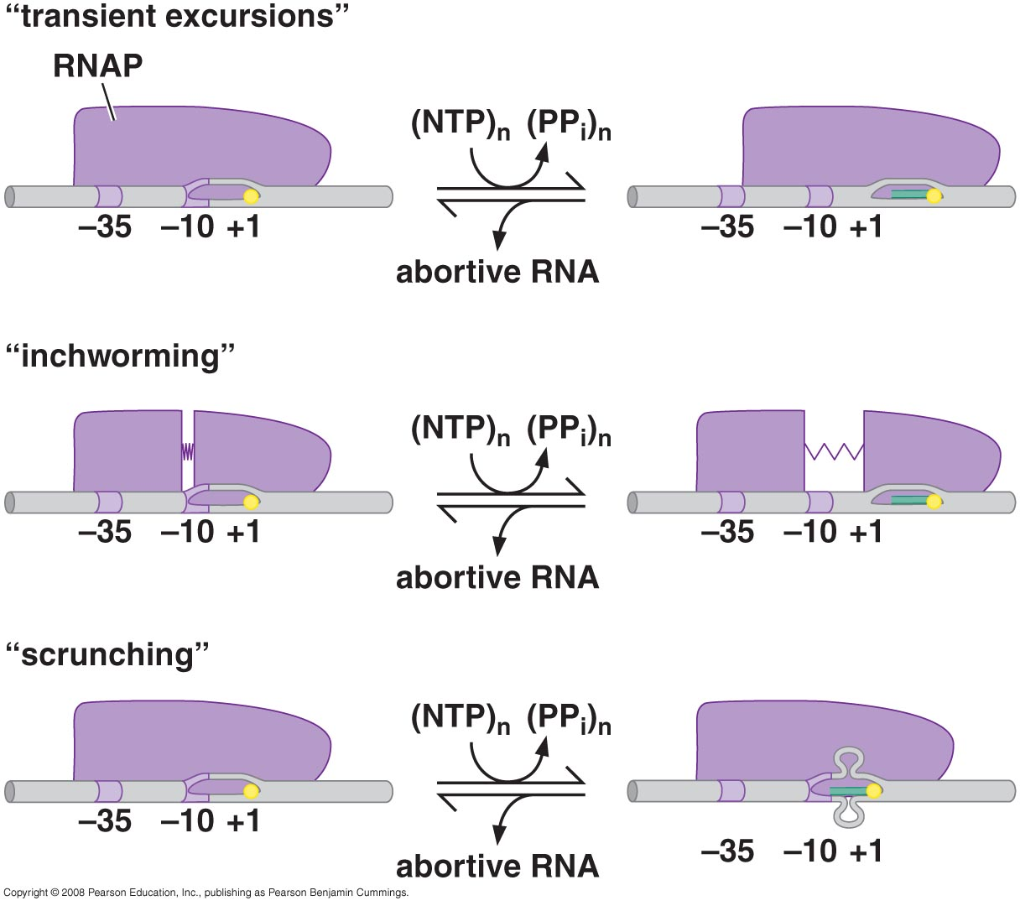
During initial transcription, RNA polymerase remains stationary and pulls downstream DNA into itself
Mechanism of initial transcription

Slide 20
Promoter escape involves breaking polymerase-promoter interactions and polymerase Core-σ interactions

Slide 22
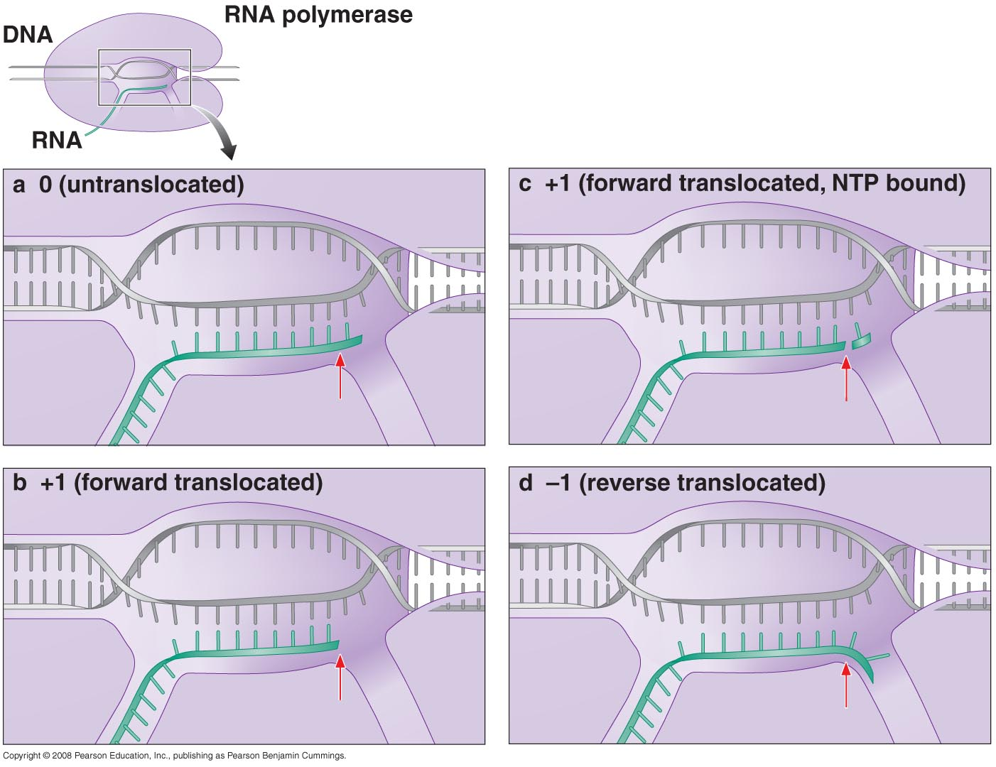
The elongating polymerase is a processive machine that synthesizes and proofreads RNA

Slide 23
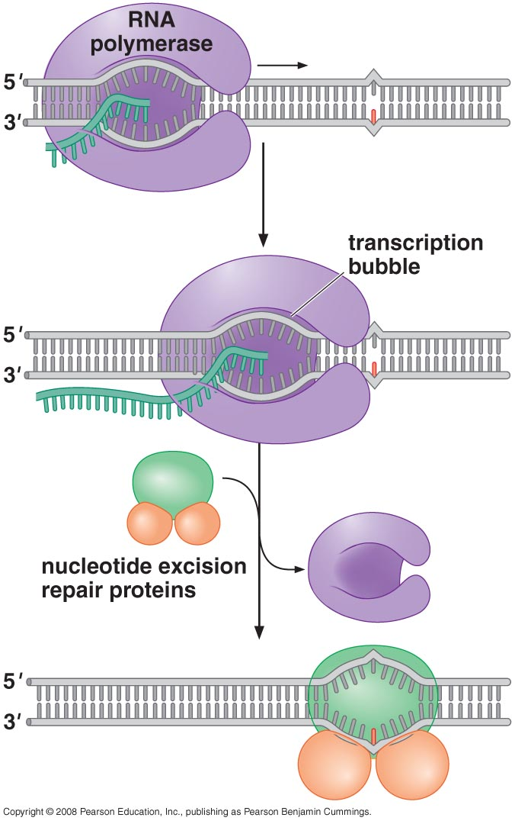
RNA polymerase can become arrested and need removing (due to damaged DNA strand)
Transcription-coupled DNA repair
(promoted by TRCF)

Slide 24
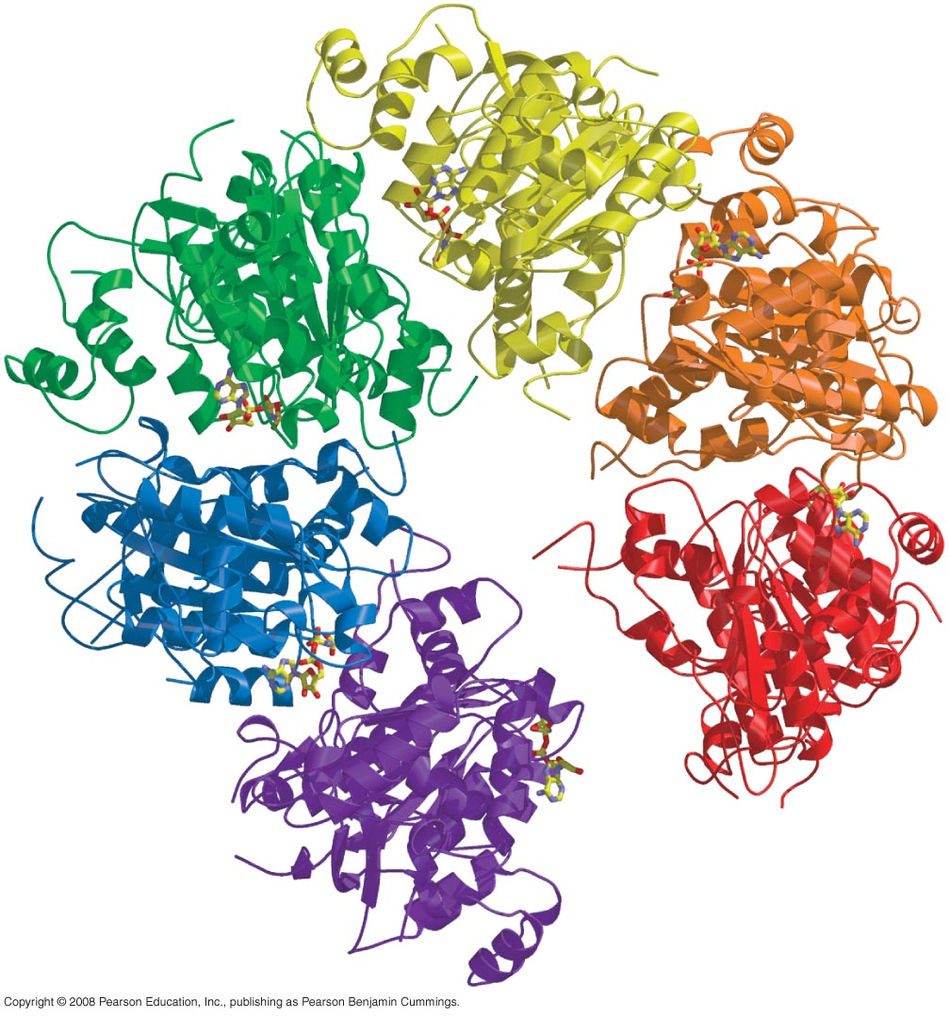
Transcription is terminated by signals within the RNA sequence (Rho-dependent and Rho-independent)
Rho protein

Slide 25
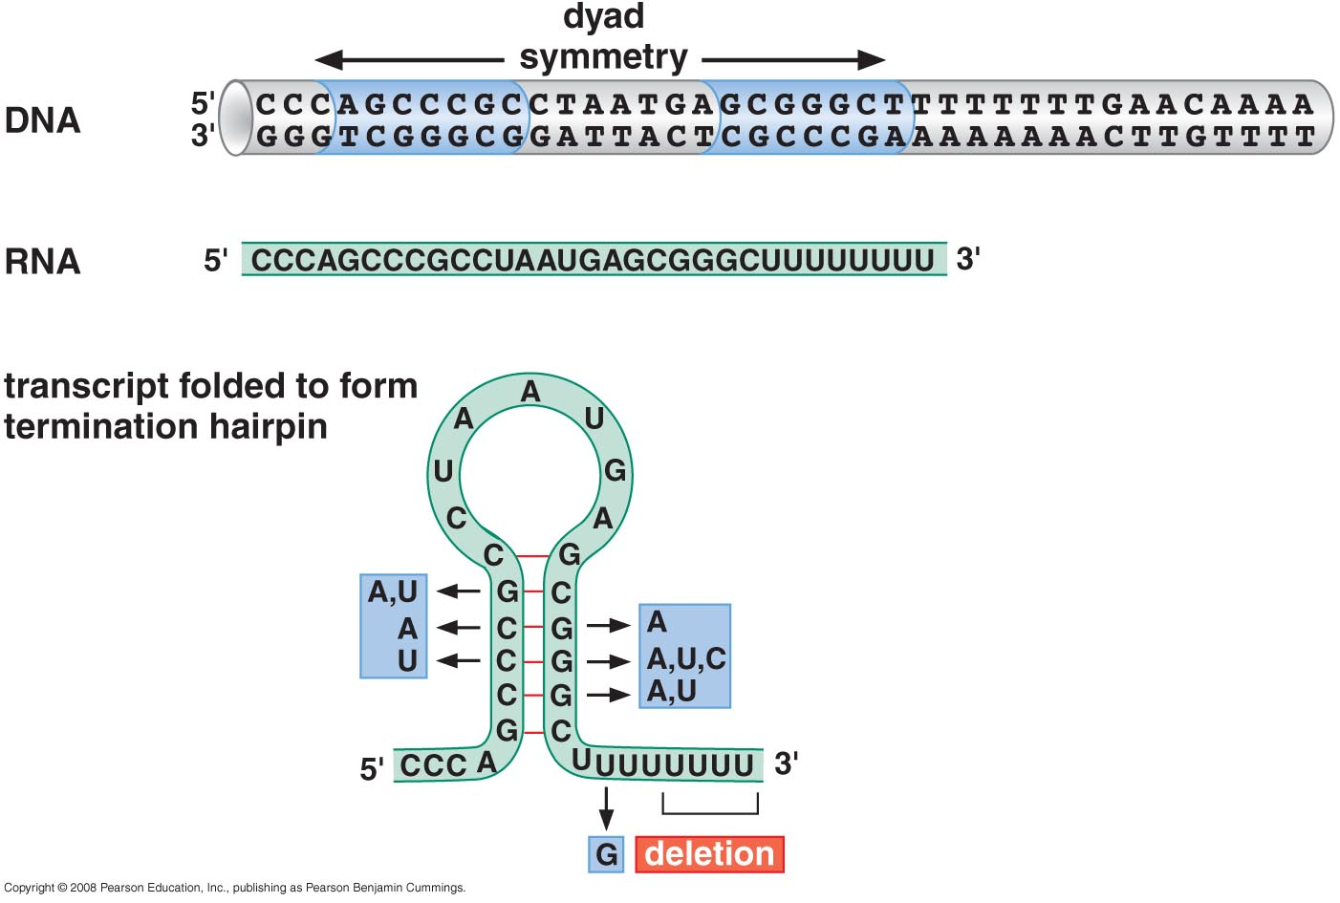
Sequence of a Rho-independent terminator

Slide 26
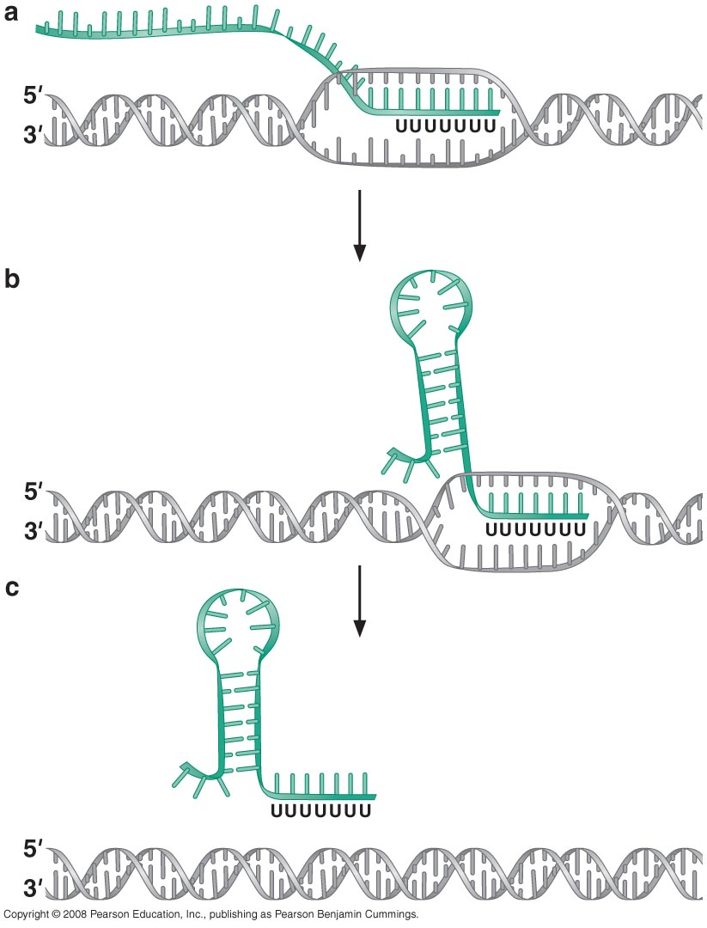
Transcription termination

Slide 27
TRANSCRIPTION IN EUKARYOTES
Transcription initiation in Eukaryotes required many proteins (requires general transcription factors and must deal with nucleosomal structures)

Slide 28
RNA polymerase II core promoters are made up of combinations of four different sequence elements

Slide 29
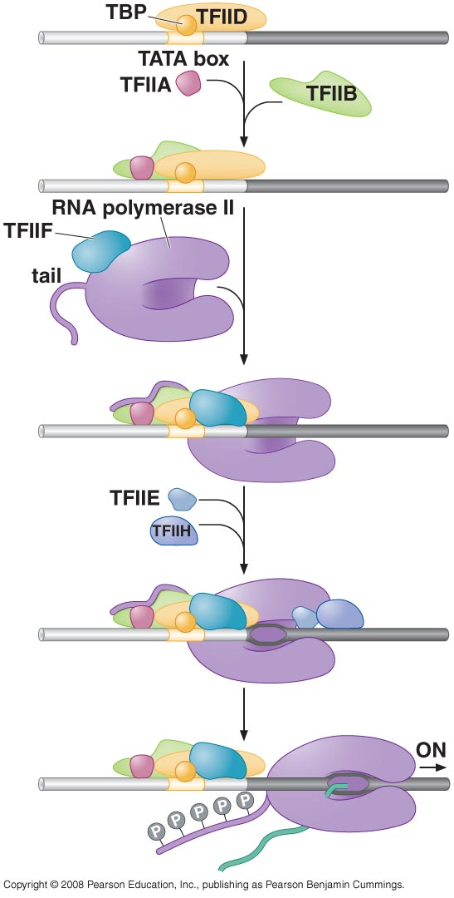
RNA polymerase II form a pre-initiation complex with general transcription factors at the promoter
Promoter escape requires phosphorylation of the polymerase “tail”

Slide 30
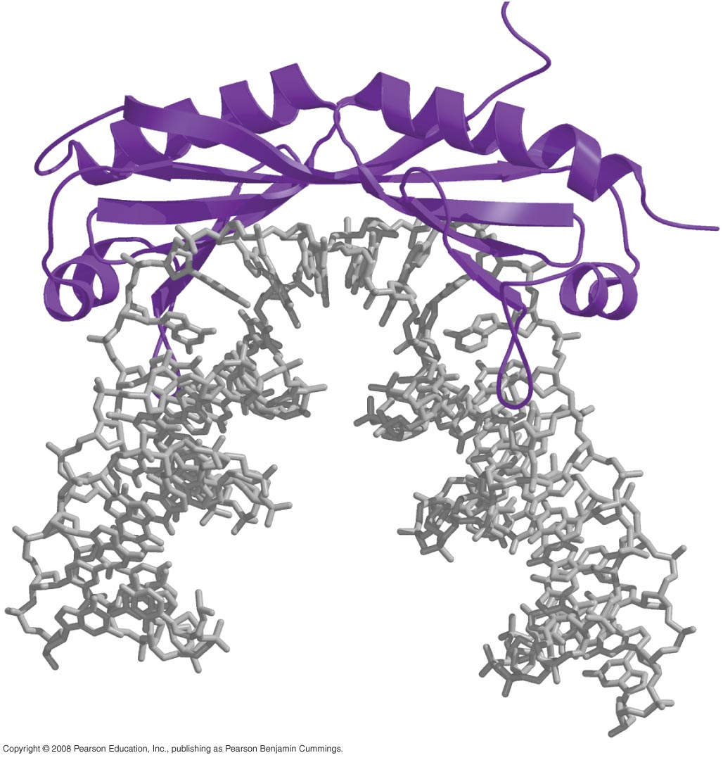
TBP binds to and distorts DNA using a β sheet inserted into the minor groove

Slide 31
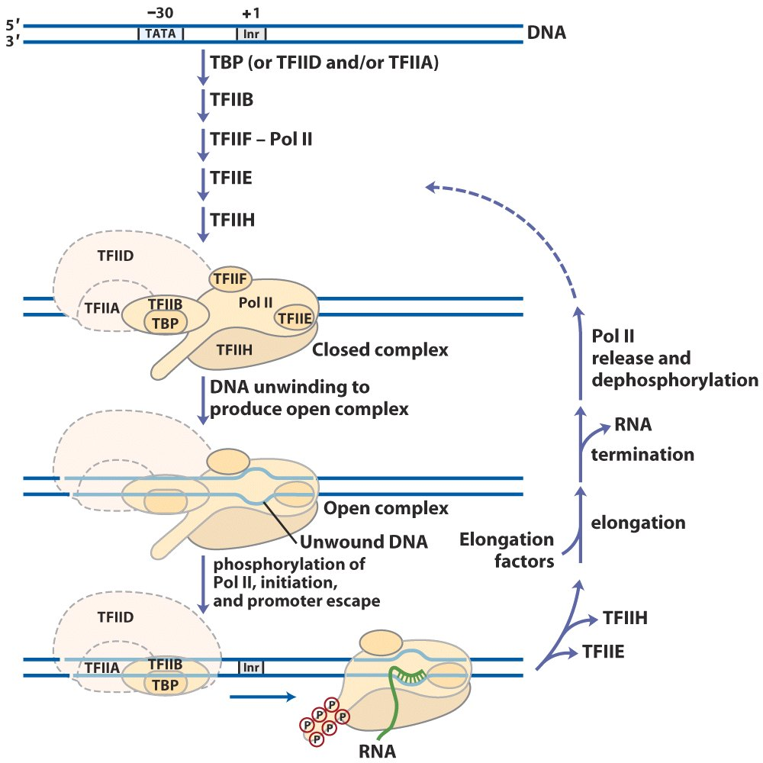
The other general transcription factors also have specific roles in initiation

Slide 32
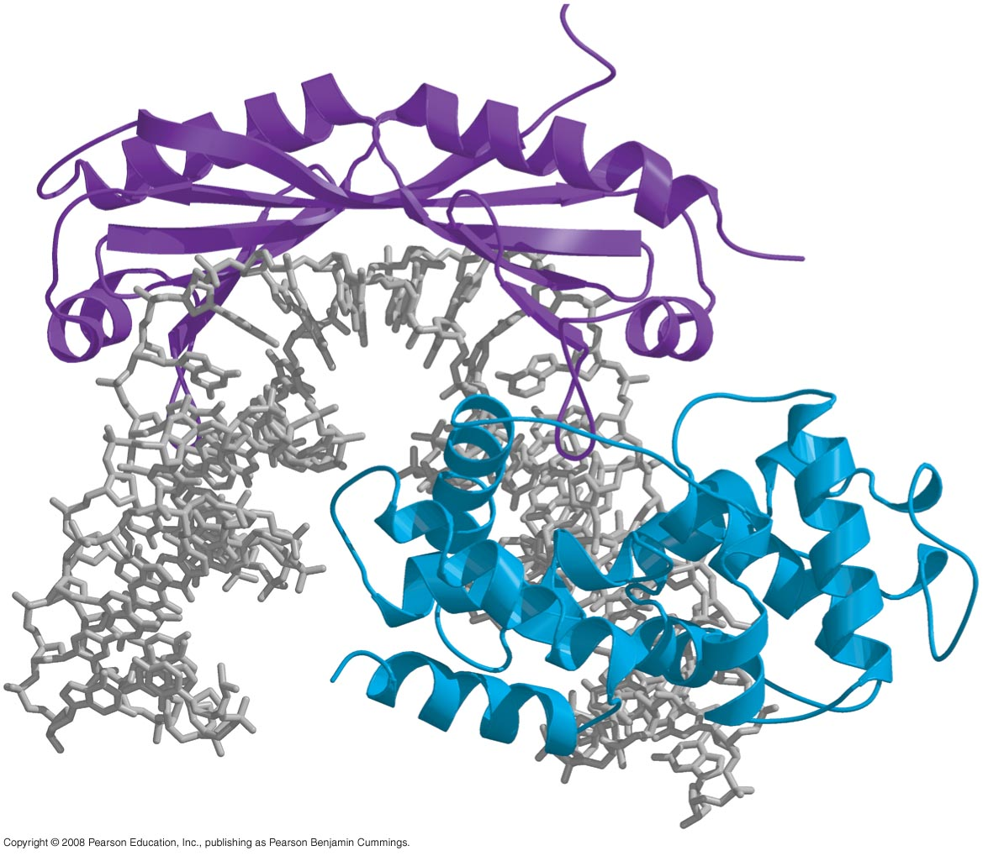
TFIIB-TBP-Promoter complex

Slide 33
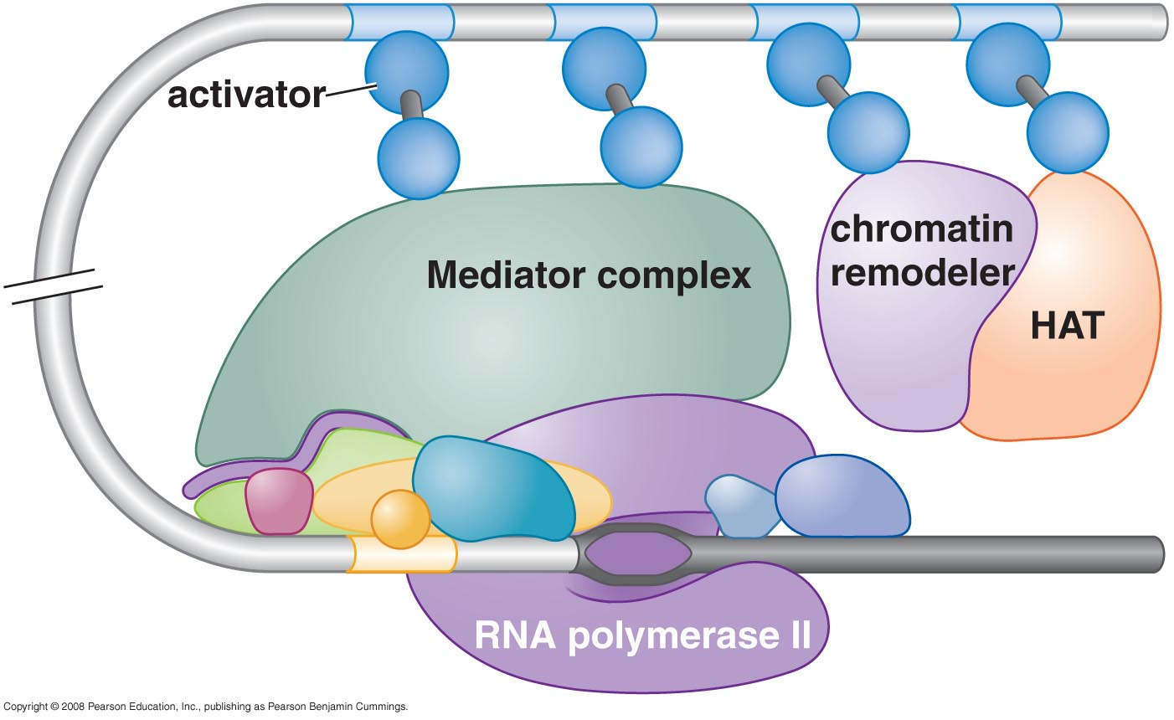
In vivo, transcription initiation requires additional proteins, including the mediator complex

Slide 34
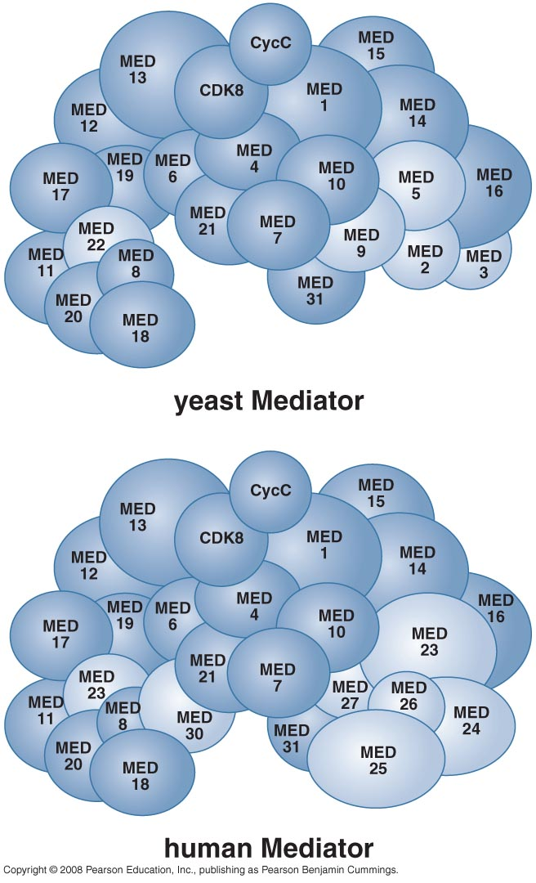
Mediator consists of many subunits, some conserved from yeast to human

Slide 35
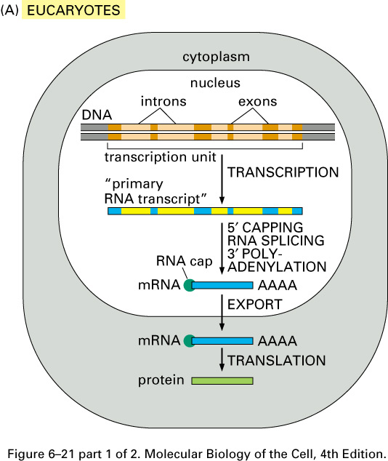
Transcription elongation in eukaryotes is tightly coupled to RNA processing
Summary of the steps leading from gene to protein in eucaryotes and bacteria. The final level of a protein in the cell depends on the efficiency of each step and on the rates of degradation of the RNA and protein molecules. (A) In eucaryotic cells the RNA molecule produced by transcription alone (sometimes referred to as the primary transcript) would contain both coding (exon) and noncoding (intron) sequences. Before it can be translated into protein, the two ends of the RNA are modified, the introns are removed by an enzymatically catalyzed RNA splicing reaction, and the resulting mRNA is transported from the nucleus to the cytoplasm. Although these steps are depicted as occurring one at a time, in a sequence, in reality they are coupled and different steps can occur simultaneously. For example, the RNA cap is added and splicing typically begins before transcription has been completed. Because of this coupling, complete primary RNA transcripts do not typically exist in the cell.

Slide 36
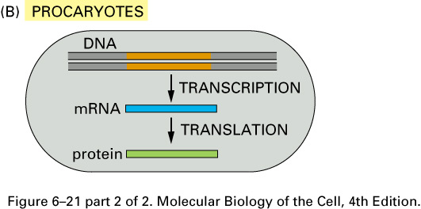
(B) In procaryotes the production of mRNA molecules is much simpler. The 5' end of an mRNA molecule is produced by the initiation of transcription by RNA polymerase, and the 3' end is produced by the termination of transcription. Since procaryotic cells lack a nucleus, transcription and translation take place in a common compartment. In fact, translation of a bacterial mRNA often begins before its synthesis has been completed.

Slide 37
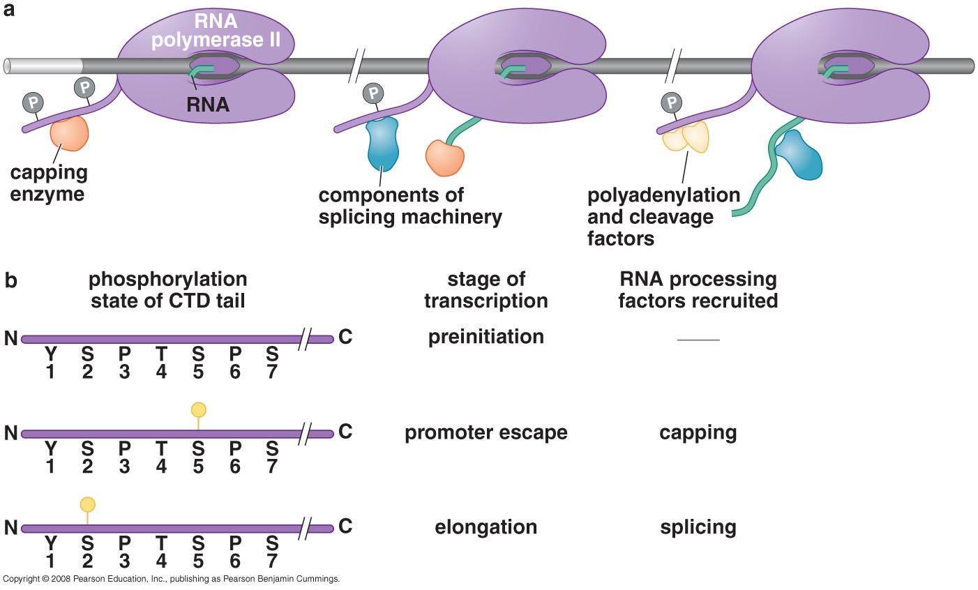
A new set of factors stimulate Pol II elongation and RNA proofreading

Slide 38
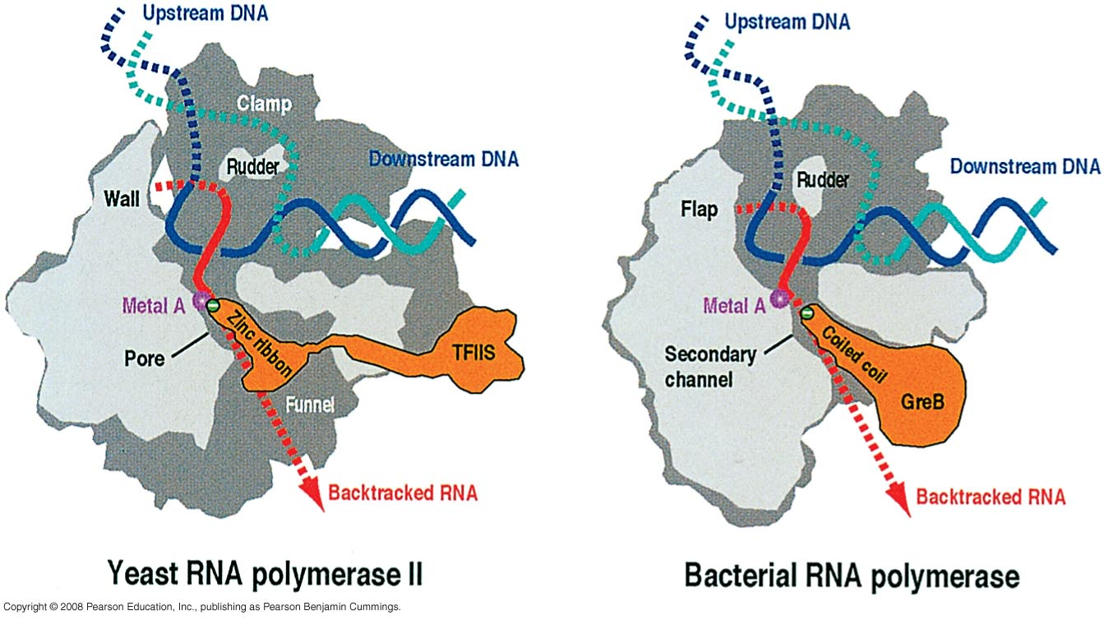
TFIIS stimulates the overall rate of elongation by limiting the time that Pol II pauses at any given site is reduced

Slide 39
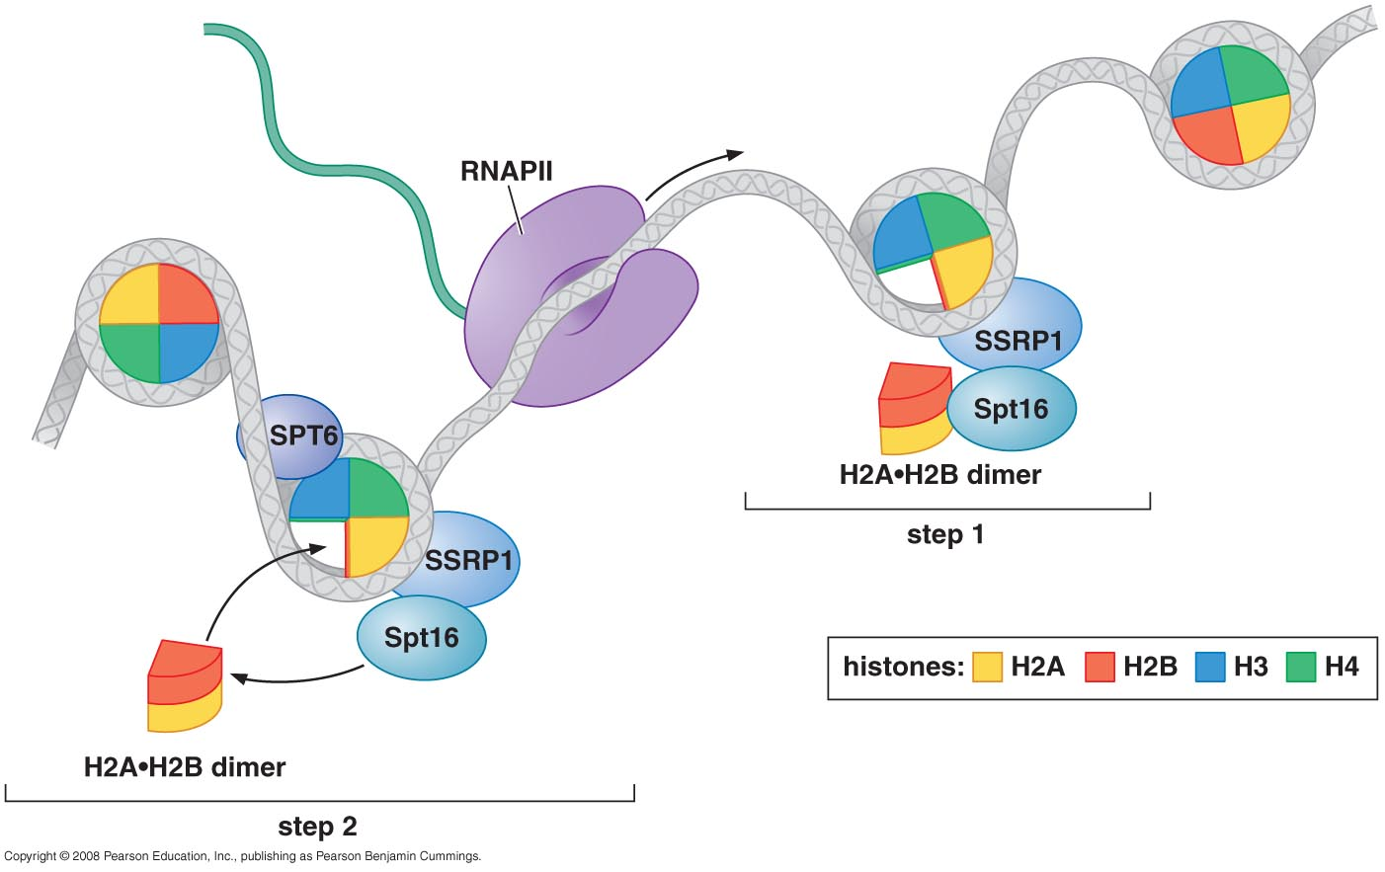
Elongating RNA polymerase must deal with histones in its path
A model of how FACT (facilitates chromatin transcription) aids elongation through nucleosomes

Slide 40
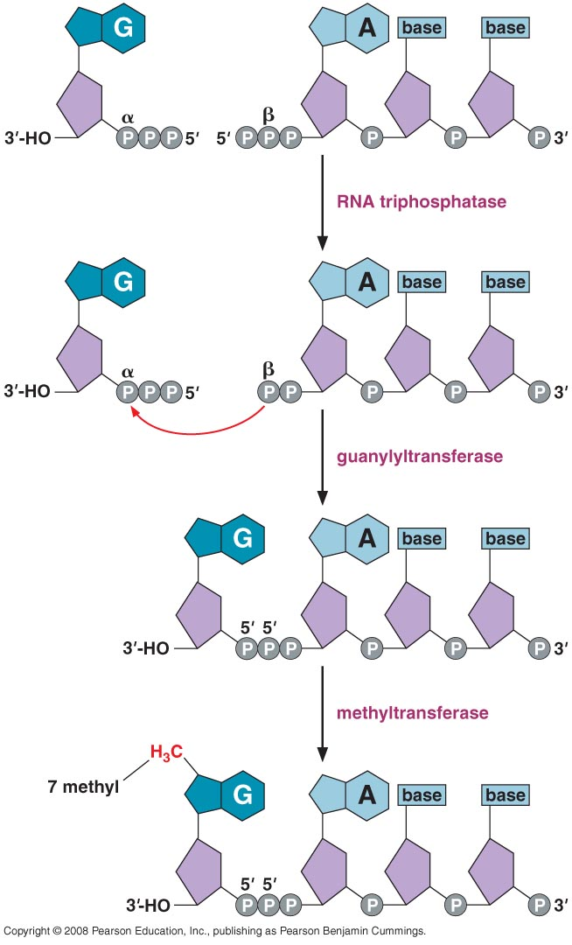
Elongating polymerase is associated with a new set of protein factors required for various types of RNA processing
The structure and formation of the 5’ RNA cap

Slide 41
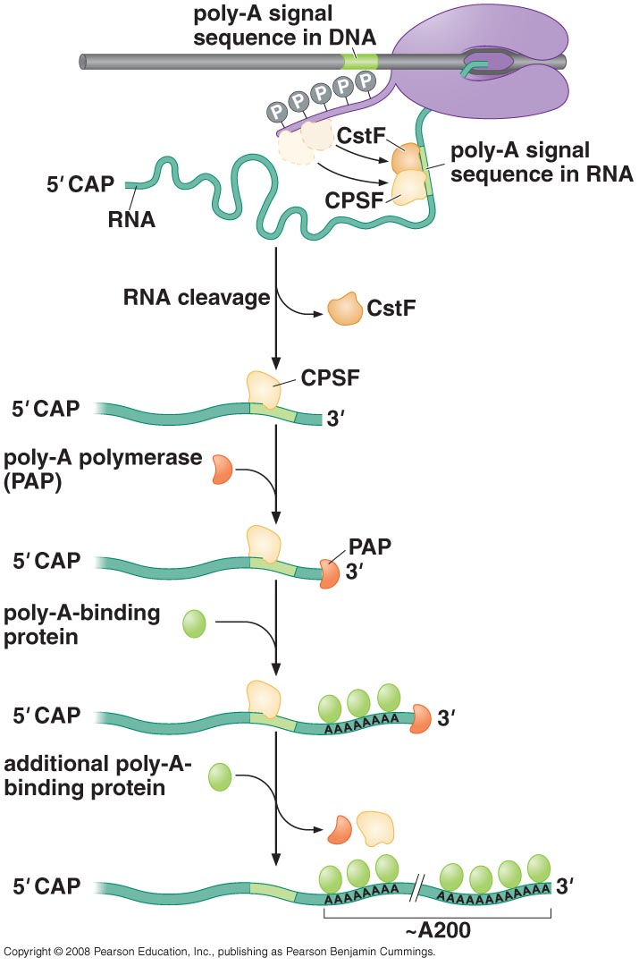
Polyadenylation and termination

Slide 42
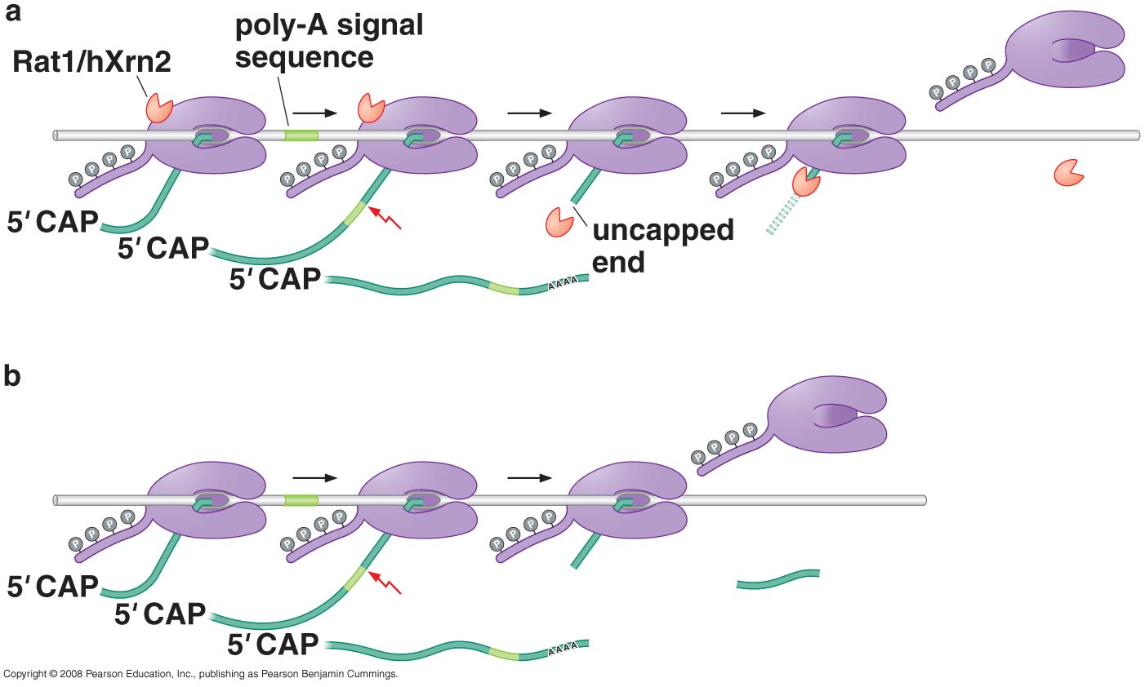
Transcription termination is linked to RNA destruction by a highly processive RNase

Slide 43
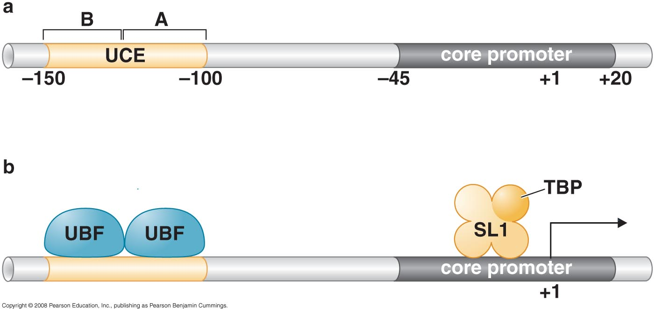
TRANSCRIPTION BY POL I & POL III
RNA pol I & III recognize distinct promoters, using distinct sets of transcription factors, but still require TBP
Pol I promoter region

Slide 44
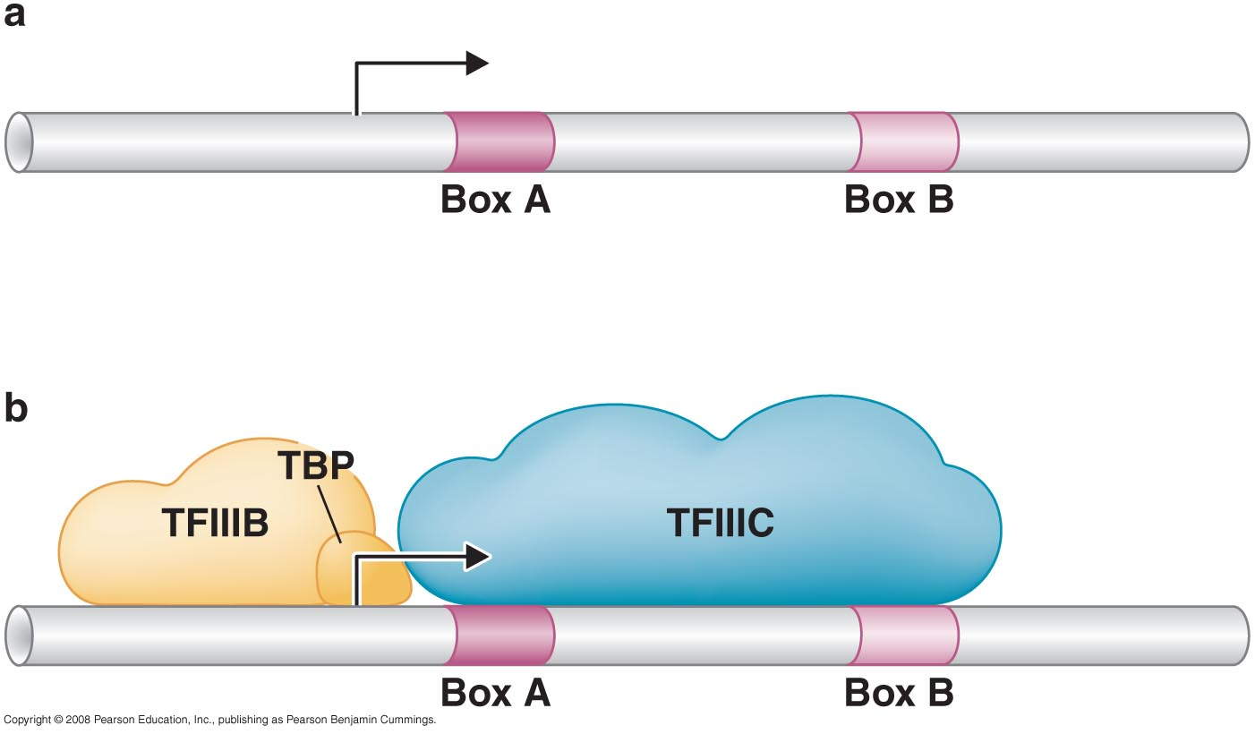
Pol II core promoter

Slide 46
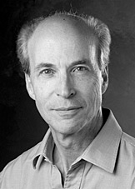
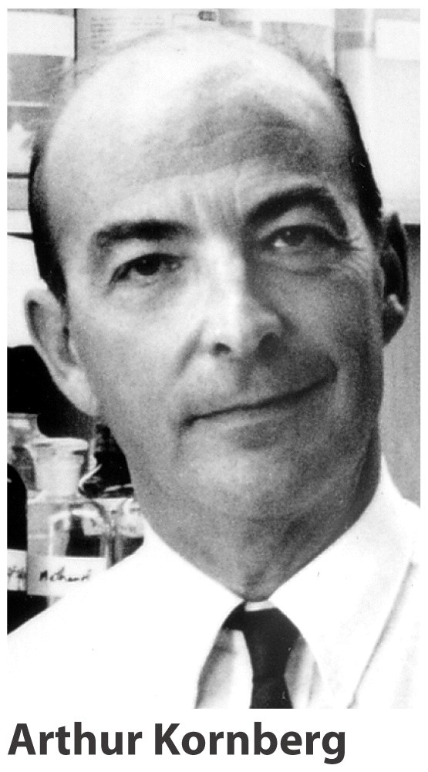
The Nobel Prize in Chemistry 2006
"for his studies of the molecular basis of eukaryotic transcription"
Roger D. Kornberg
USA
Stanford University Stanford, CA, USA
b. 1947
Arthur Kornberg
Born: 3 March 1918, Brooklyn, NY, USA
Died: 26 October 2007, Stanford, CA, USA
Affiliation at the time of the award:Stanford University, Stanford, CA, USA
Prize motivation: "for their discovery of the mechanisms in the biological synthesis of ribonucleic acid and deoxyribonucleic acid"

